Slide 1
Deployment and Server Configuration for Web Connection Applications
Rick Strahl
West Wind Technologies
west-wind.com
weblog.west-wind.com

Slide 2
Agenda
Deployment and Configuration
How do I get my Web Connection site online?
Looking at configuration from a deployment perspective
Hosting options
Specific example: Deploy to a Vultr hosted Virtual Machine instance
Server Setup
Setting up IIS
Setting up Windows and security
Deploying your Application
Copying files
Configuring your application in IIS
Managing permissions and access
Updating your Application
I made a change – now what?
Automated and manual updates

Slide 3
Deployment Then and Now
Deployment used to be Hard
Prior to Web Connection 6 deployment was wild west
You were basically on your own
Deployment is much easier in 6.0+
Well defined project structure
Each project is self contained and isolated
Relative paths make installs very portable
Tools and scripts automate configuration:
IIS Installation script
IIS configuration via ‘Console config’
Scripts to package your application
Visual Studio or FTP to publish Web content

Slide 4
Hosting Web Connection
Web Connection requires Special Consideration
Because: FoxPro has to be registered
Some Admin rights are required to install FoxPro
FoxPro COM objects have to be registered (HKLM)
FoxPro typically doesn’t run on low cost hosts
Hosting on a Virtual Machine
You can host Web Connection applications cheaply on VMs
VM is basically a cloud hosted, full Windows OS
You can have a VM up and running in about 10 minutes
I like Vultr: I pay $56/mth for 4 cores, 8gb mem, 100gb of disk
Recommend: Minimum 2 cores and 4gb memory
Pick your provider carefully – Performance varies widely

Slide 5
Server Setup
Getting an application online

Slide 6
Let the Project Structure do the Work
Project Folder
Self contained folder
Known structure
All paths can be referenced relatively
This allows for a portable install
Stick to it and it’ll be easy
Project Scripts and Tools
We provide tools for most configuration tasks
IIS Installation
IIS Configuration for your application
File packaging for upload
Re-publishing features

Slide 7
Getting your Project Ready for Deployment
Build your application into an EXE
Do a project build and build an EXE
Make sure you run as Admin so you can register the COM object
Test the Server
Run it as a compiled EXE from Explorer (not in VFP)
Switch into COM Mode and run the application under COM
Fix any errors you might run into before you upload to the server
Package up your Files
Use build.bat in the root to package your application
Compiles: Your Exe and Ini, plus all the Web Connection DLLs
Package up the Web
Web Folder – as is
Alternately we can publish through Visual Studio
Initial deploy by copying is faster

Slide 8
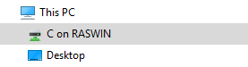
Your new Machine
Get a Remote Machine Ready (Virtual Machine)
Use a Virtual Host such as Vultr
Get a VM with minimum 2 processors and 4gb of memory
Use Remote Access (RDP) to access your Server
Remote into the machine
You can use Local -> Remote File Mapping for basic File Copying
Set up your Machine
Do a basic Machine Setup
At minimum:
Install a decent browser (Chrome or Firefox)
Install a good editor (VS Code)
Install Chocolatey
Better: Run a Chocolatey install script to install what you need

Slide 9

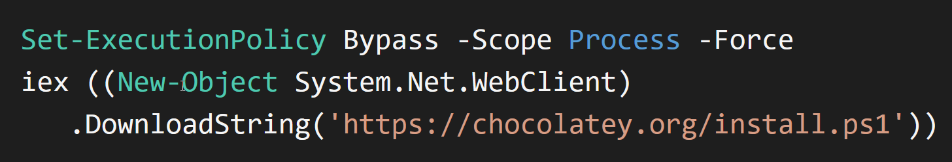
Chocolatey
Package Installer for Windows
Easy installation of most common tools and applications
Both open source and commercial installs
Allows updating of installed apps
Adds most things to the Windows path w/o clobbering PATH
Installation
Admin Powershell command (all one line) as Admin:
Go to site to copy commands for Powershell or Windows Command
https://chocolatey.org/install
Use it for Software Installations on Server and Local Machines!

Slide 10
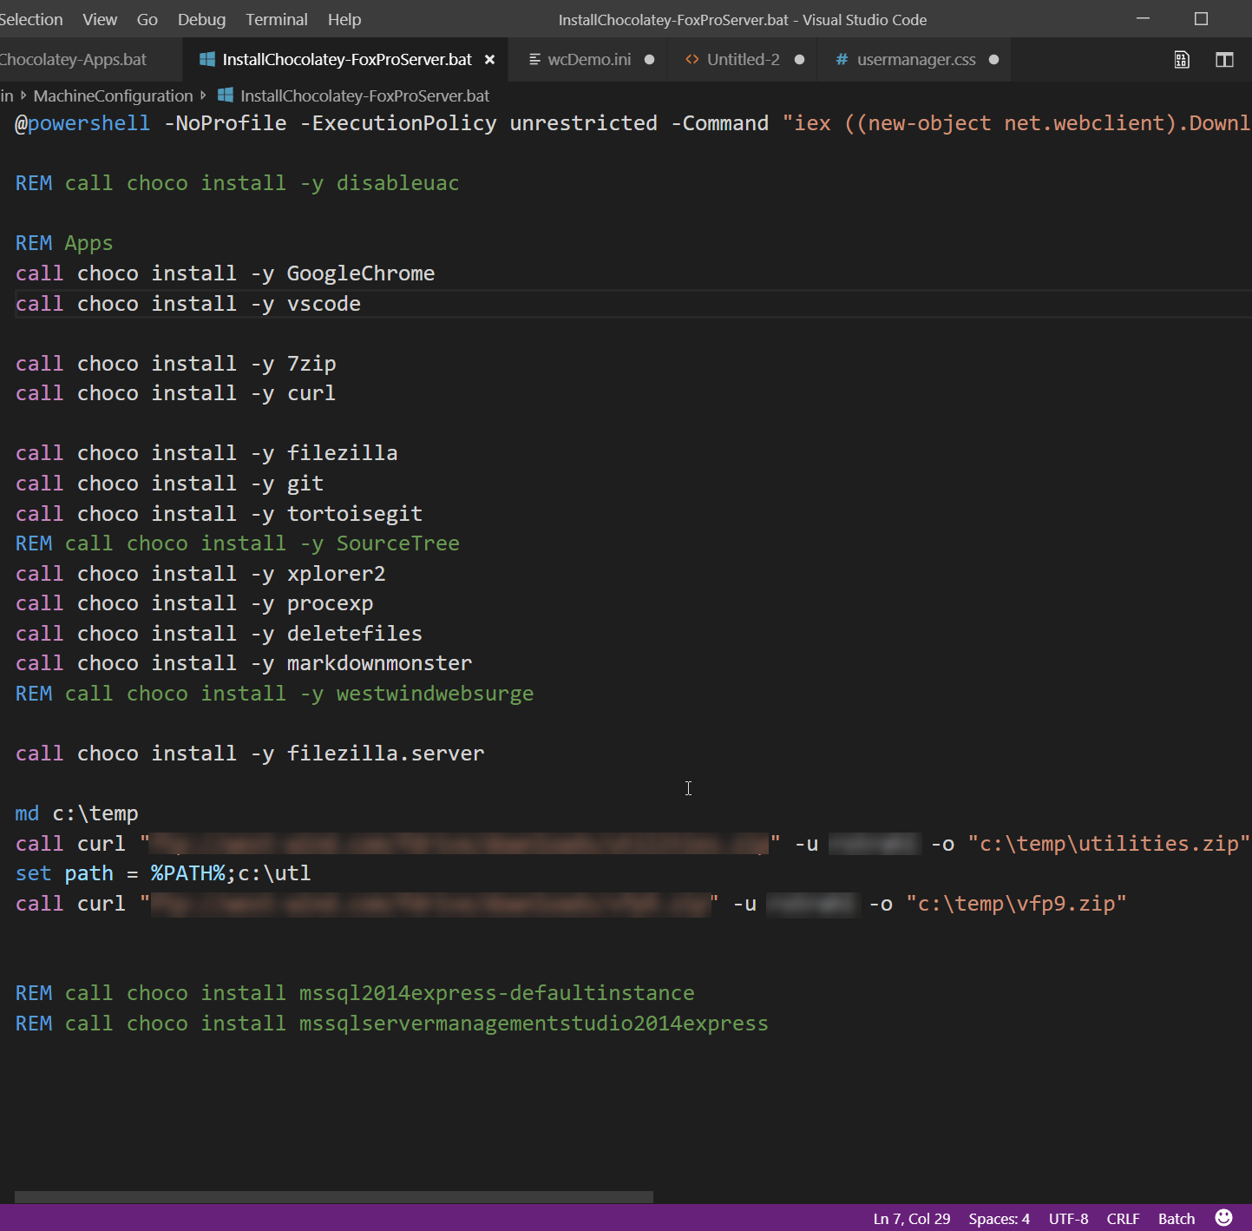

Slide 11
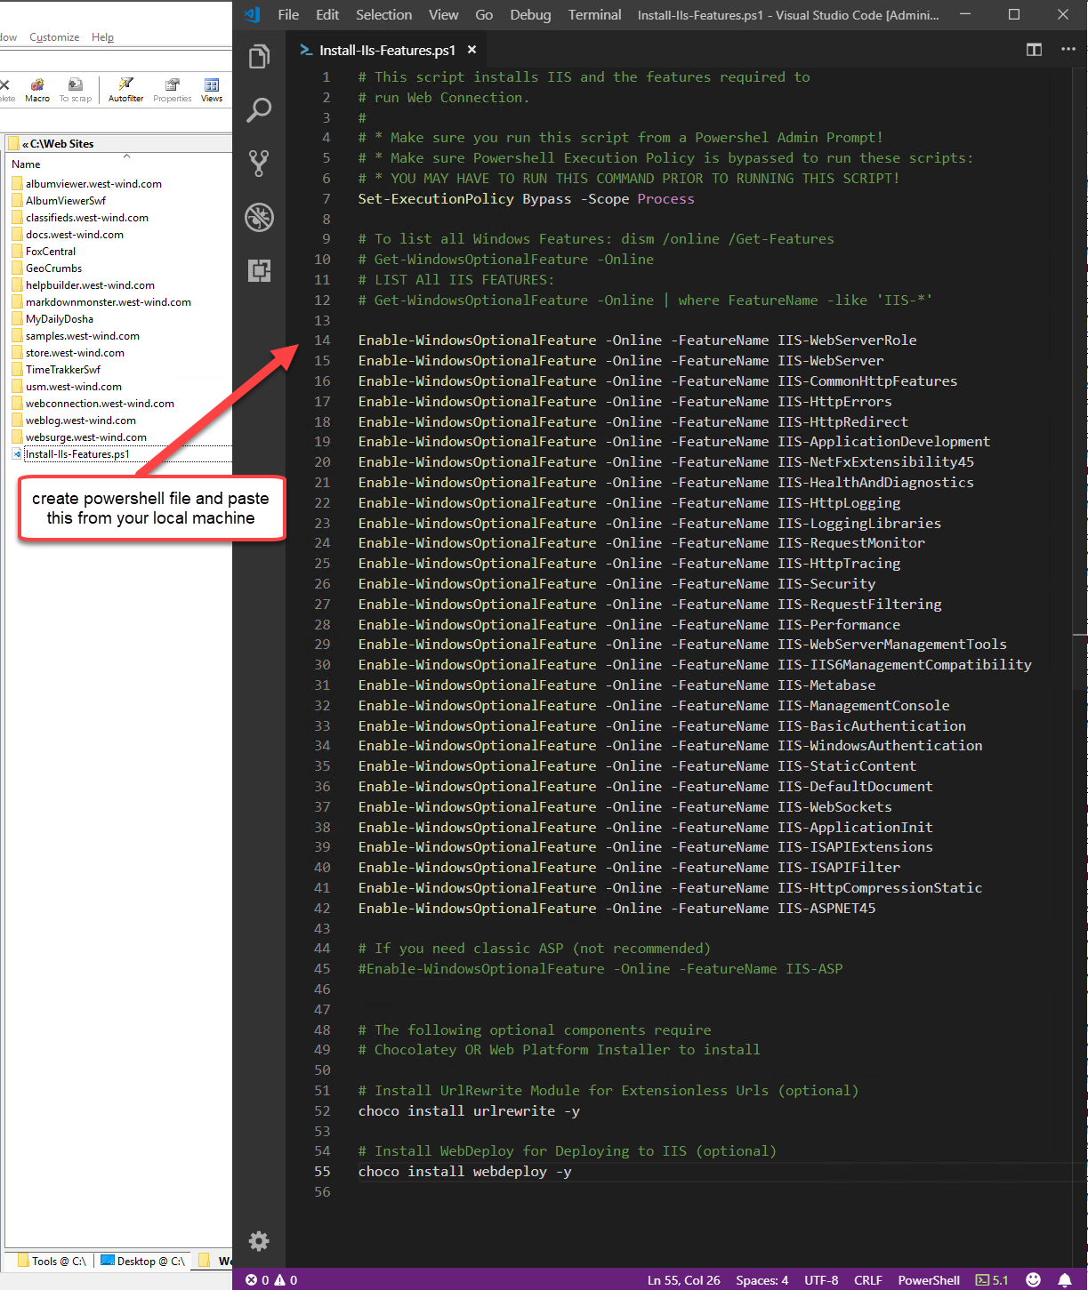
Install IIS
Install IIS
IIS will let us copy files with WebDeploy
Use Commandlets from command line
Create Powershell script
Use install-iis-features.ps1
File copied in your project root
Automates IIS Installation
Installs components needed for Web Connection
Takes out the guess work

Slide 12
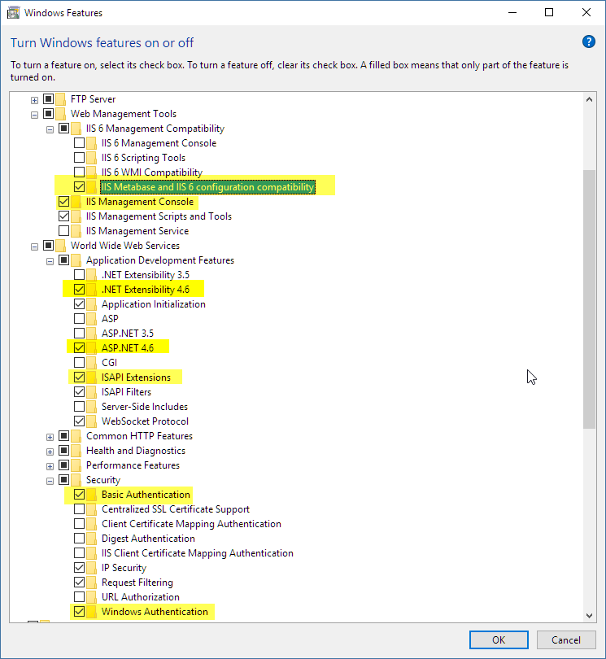
Manual IIS Installation
Windows Features
On Windows Client OS
Type Windows Features into Start Menu
Server Manager
On Windows Server OS
Server Manager -> Manage -> Add Roles
Add or Edit Web Server Role
Key Features to install
IIS 6 Metabase Compatibility
ASP.NET 4.5/6 / .NET Extensibility
ISAPI Extensions (only if you use ISAPI!)
Basic and Windows Authentication
Web Sockets for Client Installs

Slide 13
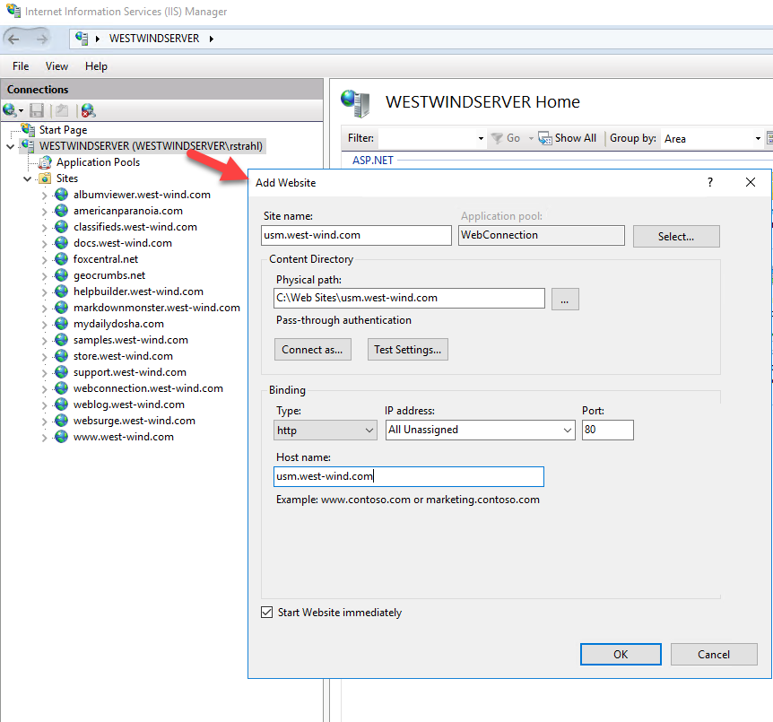
Create Site and DNS
Create a new Web Site
Add site
Point at application’s Web folder
Give it host name (DNS)
Create DNS Entry
Go to your DNS provider online
Add DNS entry for your domain
A Record: Domain -> IP Address
Your new server’s host name
Point at your server’s IP address
For Virtuals
Create virtual in your root site
Point at application’s Web folder

Slide 14
Install FoxPro
FoxPro IDE
Do you need the IDE on the Server?
For running your app: NO
For maintenance: Probably
You need to copy install to the server then install
FoxPro Runtime Installs
Runtime installs are sufficient for running Web Connection
You can install runtimes from the VFPX site: https://github.com/VFPX/VFPRuntimeInstallers
For IDE Installs
Build yourself a Zip file that contains installers
Put it on an FTP server or Shared Drive link
Download as needed to a server

Slide 15
Deploying Web Connection
Getting your files online and starting up your application

Slide 16
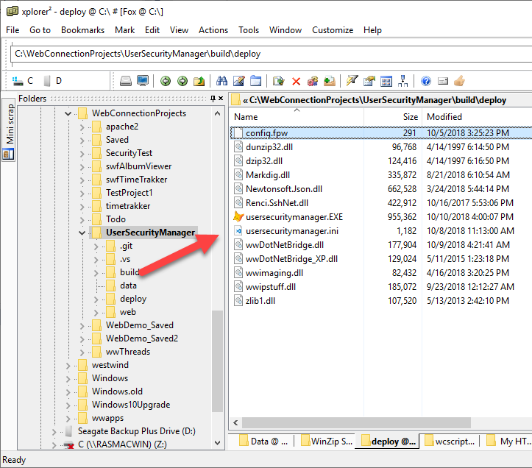
Deploy Folder
Much easier now
Known folder structure
All paths are relative
Only path that needs set is the Web Root or Virtual
build.bat to package Binaries
Packs up your EXE and INI
Adds Web Connection DLLs
Also packages Web and Data
Creates a Zip file
Executable Code
Your Exe
Your server Config Ini
Wconnect DLLS
Copy to the Server
Upload via:
FTP
RDP File Copy
Web Deploy from Web

Slide 17
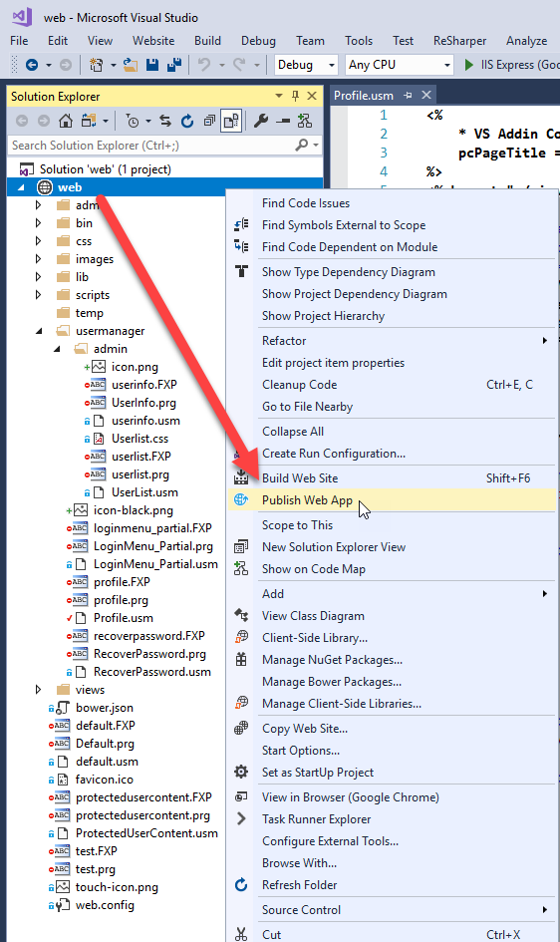
Web Folder and Web Deploy
Copied to Server as is
Everything you use for dev is needed on the server
Use Web Deploy to deploy to IIS
Web Deploy is an addon IIS Component
Install on server via Chocolatey or Platform Install choco install WebDeploy
Web Deploy can:
Deploy an entire site
Deploy individual or multiple selected files
Detect changes and only deploys what changed
Great for incrementally updating server content

Slide 18
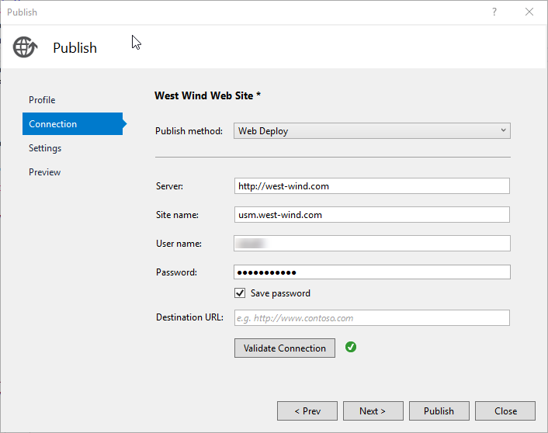
Deploy your Web Files
Steps to Deployment on Server
Web Site has to exist before you can publish to it!
Create Web Folder to match Project Structure
ie.: projectRoot\Web
Create Web Site or Virtual and map to that folder
Deploy from Client and Visual Studio
Web Deployment Odds and Ends
Use Custom -> WebDeploy as target
Server: Pick any valid Site on your server
If no domain use the IP Address
Server and Site Name don’t have to be the same
Username and password are Windows accounts
Connections are saved when you exit

Slide 19
Visual Studio Web Deploy Tips
Publish Everything
Copy your build zip into the Web temp folder
Avoids having to use FTP for your Build Files
Re-deploy
You can redeploy at any time
Web Deploy is smart enough to only copy what’s changed
Publish Individual Files
You can publish one or more selected files from Solution
You can publish the active file in the editor
Shortcut: alt-;-p
Caveat: Don’t deploy prg/fxp
Don’t deploy PRG/FXP files for scripts
Sometimes these don’t work right unless recompiled
Especially if the VFP version/SP is not exactly the same
Use a tool or command line to delete prg/fxp recursively
del /s .\web\*.prg del /s .\web\*.fxp

Slide 20
Copy the Build Package to the Server
Copy the file
Remote Desktop File Copy
Use Web Deploy
Copy Zip file to web\temp folder
Deploy the file to server
On Server Pick up the Zip File
Unzip the file into the Deploy folder
Run your EXE Server app
Make sure that it starts - it should just run
Configure IIS
Edit YourApp.Ini
Set [ServerConfiguration]: Set Web Site ID and remove Virtual
Run YourApp.exe CONFIG
Run YourApp.exe to start your server
Navigate to your site

Slide 21
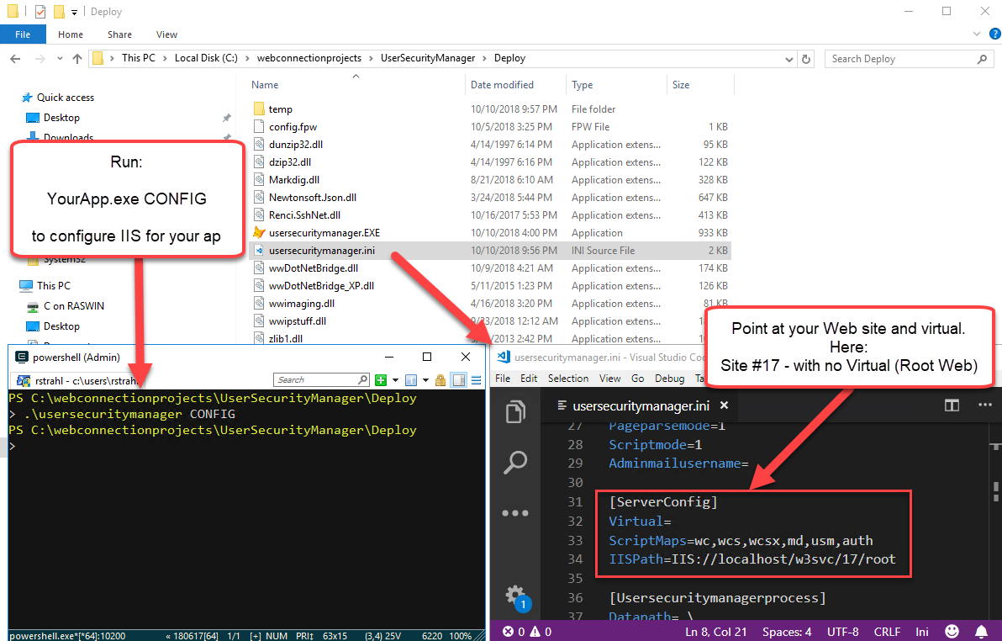

Slide 22
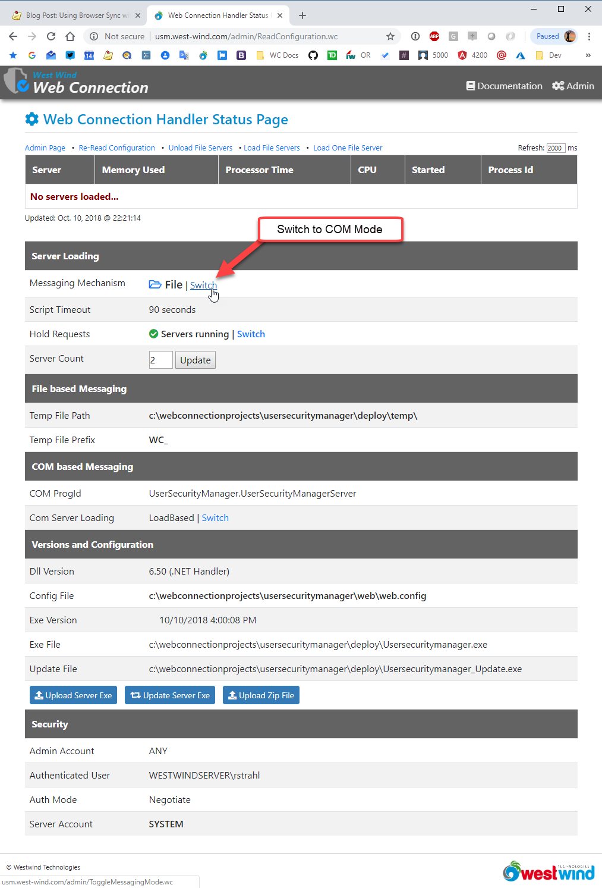
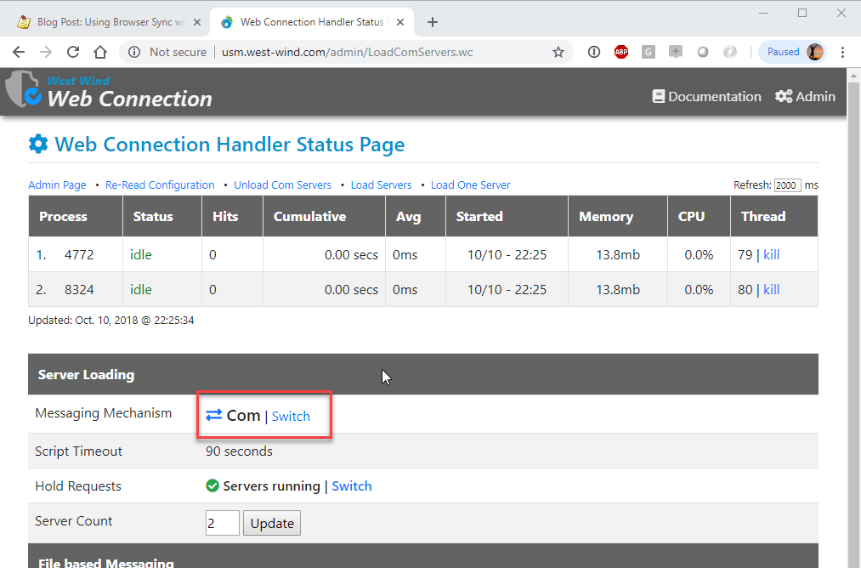
COM Mode
COM Server Registration
Server Config automatically registers COM Server
Manual Registration: YourApp.exe /regserver
Do you need DComCnfg?
Most likely no!
Launching User default Identity is recommended
Use AppPool System Identity to start – adjust later
Switch Web Connection to COM Mode
Navigate to the Administration Page http://yoursite.com/admin/admin.aspx
Navigate to the Handler Status Page http://yoursite.com/admin/ReadConfiguration.wc
Switch Messaging Mode to COM
Load COM Servers
To see if servers load use Load COM Server
Servers should show up in the list

Slide 23
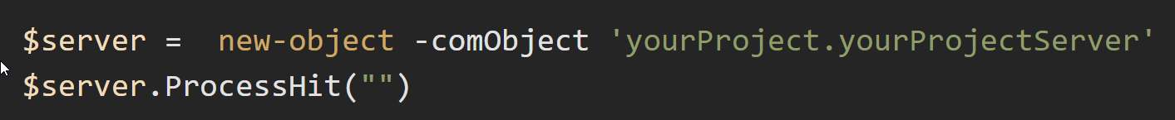
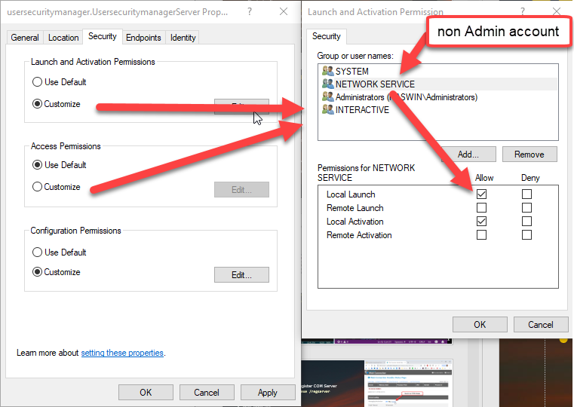
COM Servers Not Loading?
Does the Server Work outside of IIS
Check in FoxPro (if you have it installed)
Check using PowerShell
If it doesn’t work here figure out what’s wrong!
Make sure the server works on your machine
Make sure permissions and data are available
DCOM Permissions Issues
Make sure you are not using ApplicationPoolIdentity User
NEVER use this account with Web Connection
If you’re using a non-SYSTEM and non-Admin Account: Add Access and Launch and Activation Permission for that account

Slide 24
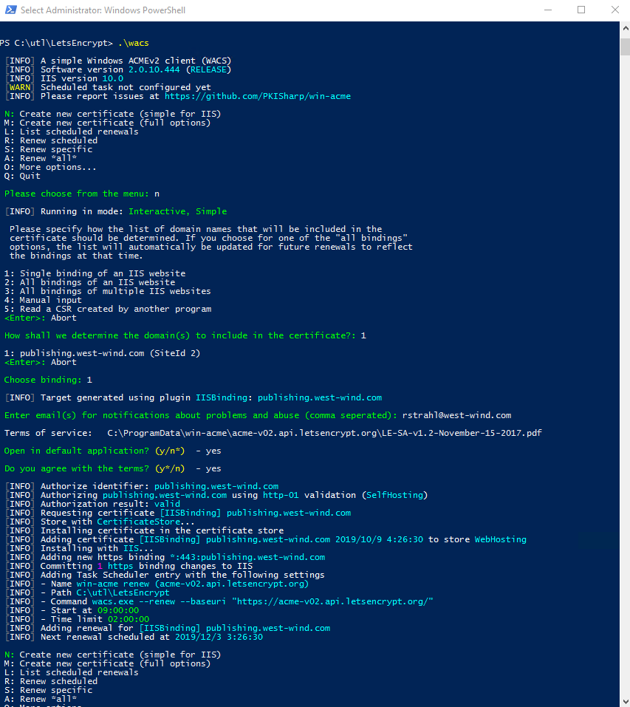
Install a SSL/TLS Certificate
LetsEncrypt Free Certificates
Free as in Free Beer
LetsEncrypt is a not for profit certificate authority
Supported by sponsorships and donations
Supported by many big industry companies
Mozilla, Facebook,
It means: You get free certificates
Fast, Automated Installation
You can be up and running with a cert in 2 minutes
The process is fully automated via standard APIs
Implementations exist for all platforms
On Windows Use Win-Acme
Command Line Tool
Really easy to use
Installs certificates into IIS
Automatically renews certificates
https://pkisharp.github.io/win-acme/

Slide 25
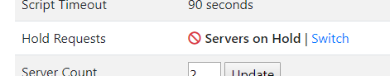
Updating your Code
Updating Web Code
Use WebDeploy from Visual Studio
Sync files
Remember to remove PRG and FXP files before publishing
On Server run in Dynamic Script Compilation Mode (1)
Updating Binaries
Update Web Connection Server with `bld_yourApp.prg`
Uploads new executable, and hot-swaps while running
Updating DLLs
Run build.bat to zip up binaries
Copy zip file to server
Module Admin: Put Servers on Hold
Now unzip and replace DLLs
Module Admin: Put Server back to Running

Slide 26
Managing Server Instances
How Many Servers Should I Run
Depends on your app’s requirements
Low access sites run 2 instances
Busy sites start with: 2 Instances per Core
Find optimal server count: Load test and look for saturation
Load Testing
Try put the site under load
You can use West Wind WebSurge
Create a typical walk through site scenario
Let it run under load
Add a large number of Web Connection Servers
Run in Load Based server mode
See if last instances are getting fired
If not firing or low volume you can dial back servers
If last ones are getting full traffic add more
Don’t add too many instances – check CPU load (over 80% is too high)

Slide 27
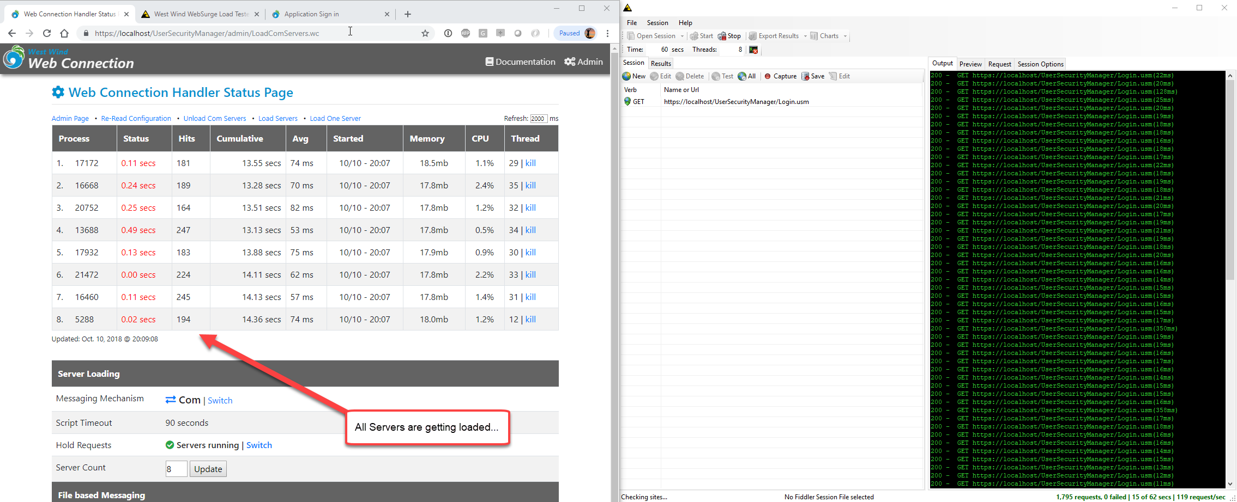
Running under Load

Slide 28
Summary
Deployment is Easier Now
Web Connection Projects are Portable
Server Configuration is mostly Automatic
Create Site and Application Pool are the only manual steps
Most Time Consuming Part is Windows Install
Installing App on Server – use Chocolatey!!!
Installing IIS
Uploading initial files
Getting Files Up to the Server
RDP Drive Mapping for initial files (config files and scripts)
For Web Files use Web Deploy from Visual Studio
For binaries you can use Web Deploy and upload as temp files
Server Config
Server Config is mostly automated now

Slide 29
Thank you!
Resources
Github: Source Code, White Paper and Slides https://github.com/RickStrahl/SWFOX2019_WebConnectionDeployment
Contact Rick
@RickStrahl on Twitter
https://weblog.west-wind.com
https://west-wind.com/wconnect/weblog/
rstrahl@west-wind.com

